Slide 1
MACHINE LEARNING
Feature Extraction
Muhammad Afif Hendrawan, S.Kom., M.T.

Slide 2
Outlines
The Relation Between Recognition, Pattern, Feature, and Feature Extraction
Feature Extraction on Various Types of Data
Introduction to Preprocessing
Data Imputation
Normalization
Standardization
Encoding
Splitting Data Strategy

Slide 3
The Relation Between Recognition, Pattern, Feature, and Feature Extraction

Slide 4

What is Recognition and Pattern?
Recognition is regarded as a basic attribute of human beings, as well as other living organisms.
Recognition is carried out by looking for pattern, namely, the description of an object

Slide 5
Types of Recognition
The recognition of concrete items
Recognizing characters, pictures, musics, or objects around us.
This is called as sensory recognition (visual and aural pattern recognition).
The recognition of abstract items
Recognizing old argument, solution of problem, while eyes and ear closes.
This is called as conceptual recognition.

Slide 6
Pattern Recognition
The categorization of input data into identifiable class via the extraction of significant features or attributes of the data from a background of irrelevant detail.
Recognition is to distinguish and classify object.
The problem is the discrimination of the input data between population via the search of features or invariant attributes among members of population.

Slide 7
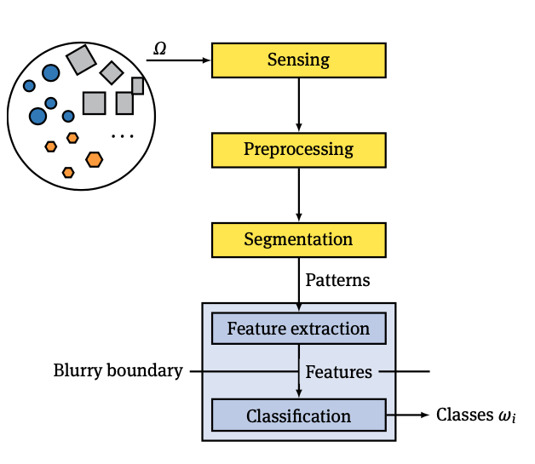
A Pattern Recognition System
(Beyerer, J., et al, 2017)

Slide 8
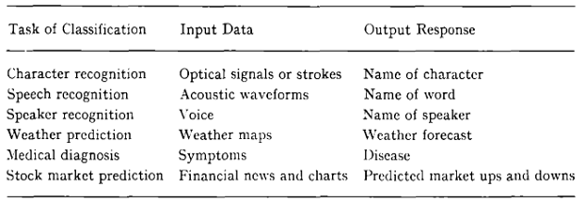
Pattern Recognition on Classification Task

Slide 9
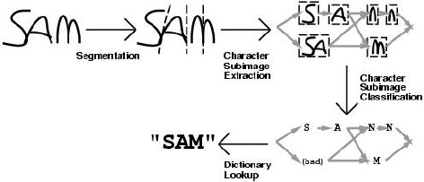
What is feature?
Feature is numeric representation of raw data.
Feature is attribute, characteristic, traits, marks, or something special about an object.
(Breuel, 2001)

Slide 10
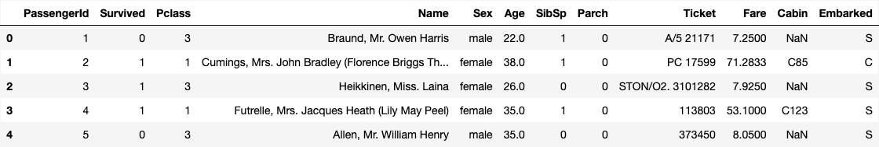
What is Feature Extraction?
A process of dimensionality reduction by which an initial set of raw data is reduced to more manageable groups of processing
These are dimensions

Slide 11
Feature Extraction on Various Data

Slide 12
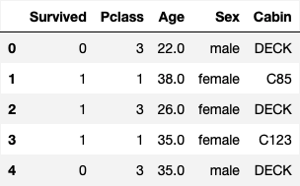
Feature Extraction on Structured Data

Slide 13
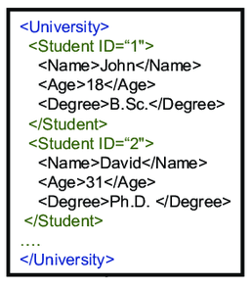
Feature Extraction on Semi-Structured Data

Slide 14
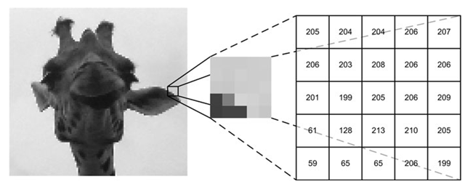
Feature Extraction on Unstructured Data

Slide 15
Introduction to Preprocessing

Slide 16
What is Preprocessing?
The process of manipulation or dropping of data before it is feeded or used to another process in order to ensure or enhance the performance of machine learning algorithms
There are several process that can be done in preprocessing, namely,
Data imputation
Normalization
Standardization
Resizing
Encoding
More . .

Slide 17
Data Imputation
Filling the missing data with another value.
Data imputation strategies,
Specific value
Mean
Median
Mode
KNN
Interpolation
More . .

Slide 18
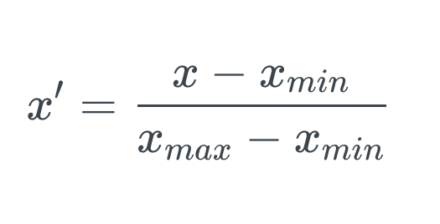
Normalization
Scaled the data into range of 0 - 1.
Using this following formula

Slide 19
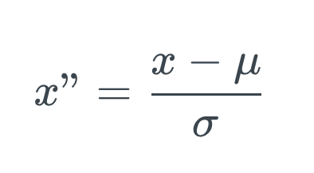
Standardization
Standardized the data by removing the mean (mean=0) the scaling the standard deviation to 1
Using this following formula

Slide 20
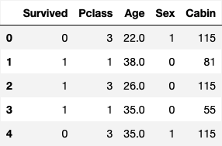
Encoding
The process of converting the data into specified format
Several encoding strategy,
Ordinal Encoding
Label Encoding
One-Hot Encoding
Dummy Encoding

Slide 21
Splitting Data Strategy

Slide 22
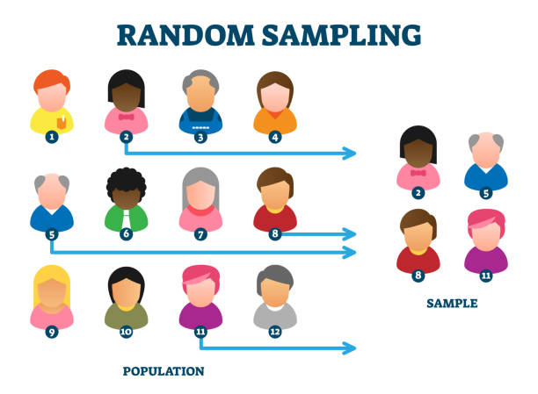
Random Split

Slide 23
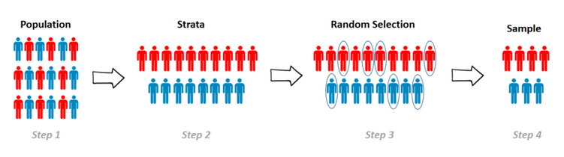
Stratified Split

Slide 24
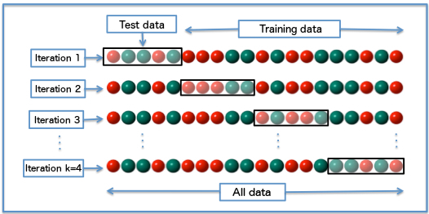
Cross Validation

Slide 25
Let’s get your hands dirty!
Feature Extraction Practice!

